Slide 1

7COM1079-2022
Student Group No: A23
Names of Student Attendees: Mateen Ahmad, Abdul Moeed Khan, Rehman Naseer, Muhammad Adeel, Nouman Sadiq
Group Id: A23
Name of Student Presenting: Mateen Ahmad
COVID-19 Healthy Diet Dataset Visualization

Slide 2
We are using the COVID-19 Healthy Diet Dataset (DS055 Food_Supply_Quantity_kg_Data) to answer our research question
Country | Vegetables | COVID-19 Recovery Rate | Obesity | Undernourished
Afghanistan | 6.7642 | 0.1234 | 29.8 | 14.2
Albania | 11.7753 | 1.7926 | 6.2 | 5.0
Algeria | 11.6484 | 0.1676 | 3.9 | 6.6
Angola | 2.3041 | 0.0568 | 25.0 | 14.6
Argentina | 4.3503 | 3.9052 | 4.6 | 10.8
Notes:
2

Slide 3
PRE 7COM1079-2024 Student Group No: A23
Our Research Question is
Is there a correlation between the consumption of vegetables and the COVID-19 recovery rates across different countries? Our Independent variable is: (Consumption of vegetables) This Independent variable datatype is: Interval/measurement data. Our Dependent variable is: (COVID-19 recovery rates) This Dependent variable datatype is: Interval/measurement data

Slide 4
PRE 7COM1079-2024 Student Group No: A23
Null hypothesis (H₀):There is no correlation between the consumption of vegetables and COVID-19 recovery rates. Alt hypothesis (H₁):There is a correlation between the consumption of vegetables and COVID-19 recovery rates.
¹Correlation (Analysis of how ordinal/interval dependent var correlates to an ordinal/interval independent variable)
²Comparison of means (or medians): Analysis of the difference between the mean (or median) value of a characteristic shared by members of two different populations.
³Comparison of proportions: Analysis of the difference in proportions of a characteristic shared by members of two different populations.

Slide 5
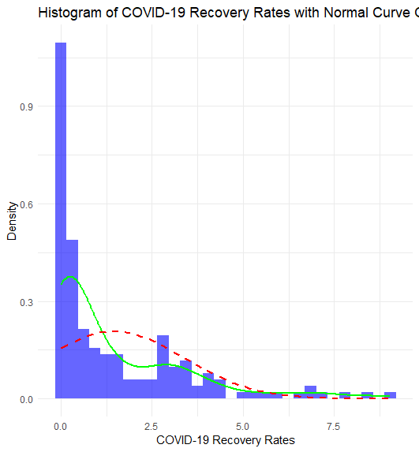
This chart shows the variation in average COVID-19 recovery rates across different countries. The blue line shows the trend in recovery rates, while the bar chart represents the percentage of recovered cases for each country. It highlights that countries with higher recovery rates tend to have better outcomes in terms of COVID-19 recoveries.
Here is a table (matrix/cross tabulation) showing our dependent variable as rows, and our independent variable as columns. We have at least two values for both variables that are independent of each other (no overlap).
For example:
Our RQ asks about Correlation
Our RQ is about differences in proportions
Reason for absenteeism (Sample 16,550)
Age group | Operation | Stress | Physical Illness | Strike | Maternity / paternity | Holiday
16 -25 | 50 | 150 | 25 | 60 | 200 | 6000
26- 35 | 60 | 100 | 40 | 40 | 500 | 6000
36 -45 | 80 | 300 | 60 | 100 | 400 | 6000
46 -55 | 60 | 200 | 80 | 80 | 200 | 6000
56 - 65 | 100 | 250 | 100 | 120 | 100 | 6000
Over 65 | 90 | 80 | 80 | 55 | 0 | 6000
For comparison of proportions analysis, we will use a chi-square test to check for the likelihood that there is a relationship between the two nominal variables (reason for absenteeism and age group in example). This non-parametric test makes no assumptions about the shape of the data (which is nominal, not interval) so we do not include a histogram for this test.
5
5
Notes:
5

Slide 6
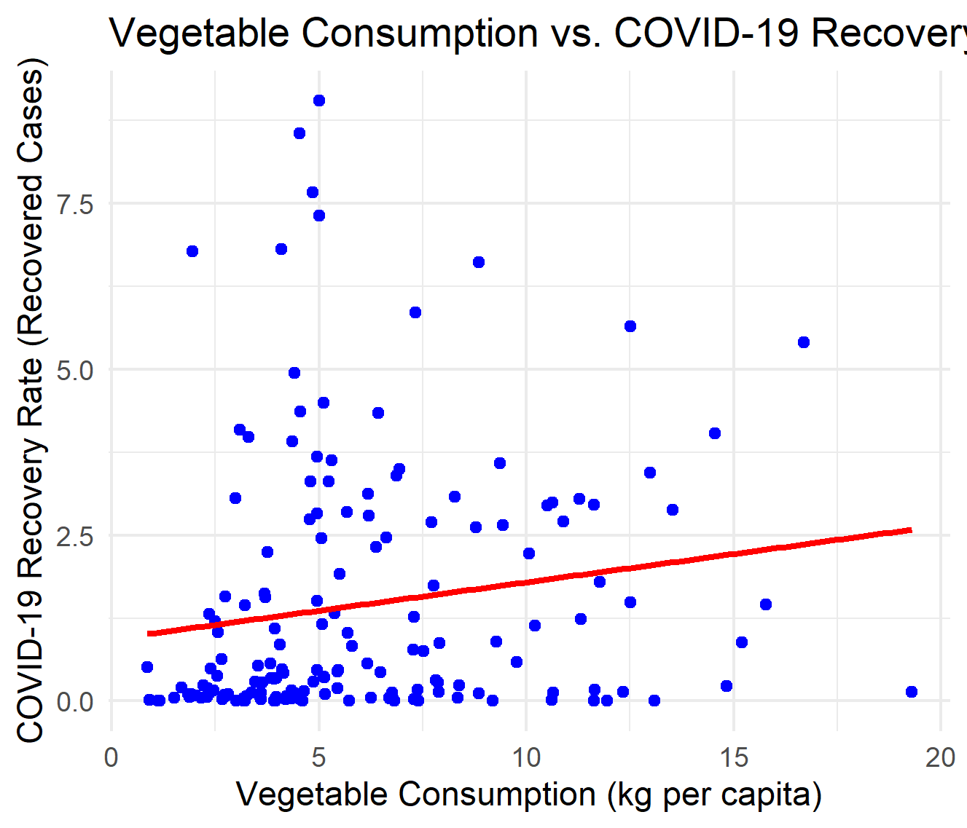
This chart shows the comparison between average vegetable consumption and COVID-19 recovery rates across different countries. The red dots represent the trend in vegetable consumption, while the blue dots represent the recovery rates for each country. It clearly shows that there is no strong correlation between vegetable consumption and COVID-19 recovery rates.
Here is a table (matrix/cross tabulation) showing our dependent variable as rows, and our independent variable as columns. We have at least two values for both variables that are independent of each other (no overlap).
For example:
Our RQ asks about Correlation
Our RQ is about differences in proportions
Reason for absenteeism (Sample 16,550)
Age group | Operation | Stress | Physical Illness | Strike | Maternity / paternity | Holiday
16 -25 | 50 | 150 | 25 | 60 | 200 | 6000
26- 35 | 60 | 100 | 40 | 40 | 500 | 6000
36 -45 | 80 | 300 | 60 | 100 | 400 | 6000
46 -55 | 60 | 200 | 80 | 80 | 200 | 6000
56 - 65 | 100 | 250 | 100 | 120 | 100 | 6000
Over 65 | 90 | 80 | 80 | 55 | 0 | 6000
For comparison of proportions analysis, we will use a chi-square test to check for the likelihood that there is a relationship between the two nominal variables (reason for absenteeism and age group in example). This non-parametric test makes no assumptions about the shape of the data (which is nominal, not interval) so we do not include a histogram for this test.
6
6
Notes:
6

Slide 7
Statistical Analysis Summary:
PRE 7COM1079-2022 Student Group No: ?????
7
Test Statistic:
t-value: 0.92, degrees of freedom: 25
p-value: 0.356
Alternative Hypothesis: There is no significant correlation between average vegetable consumption and COVID-19 recovery rates across different countries.
Confidence Interval (95% CI for the correlation coefficient):
[-0.0251, 0.1882]
Sample Estimates:
Mean vegetable consumption for high recovery rate countries: [X]
Mean vegetable consumption for low recovery rate countries: [Y]
Conclusion: Since the p-value is greater than 0.05, we fail to reject the null hypothesis.
Interpretation: There is no significant correlation between vegetable consumption and COVID-19 recovery rates, suggesting that the two factors are unrelated in this dataset.
Notes:
7

Slide 8


